Slide 1
Maximize Your Business Brand as a
Certified WBE

Slide 2
Topics
Foundational Knowledge
Organizational Background
The Value Proposition
Supplier Diversity Advantages
Role of SD Professionals
Maximizing Your Certification
Benefits of Certification
Incorporate Seal in Brand
Prospecting in WBENC Community
Participate in Your RPO
Engaging in WBENC National

Slide 3
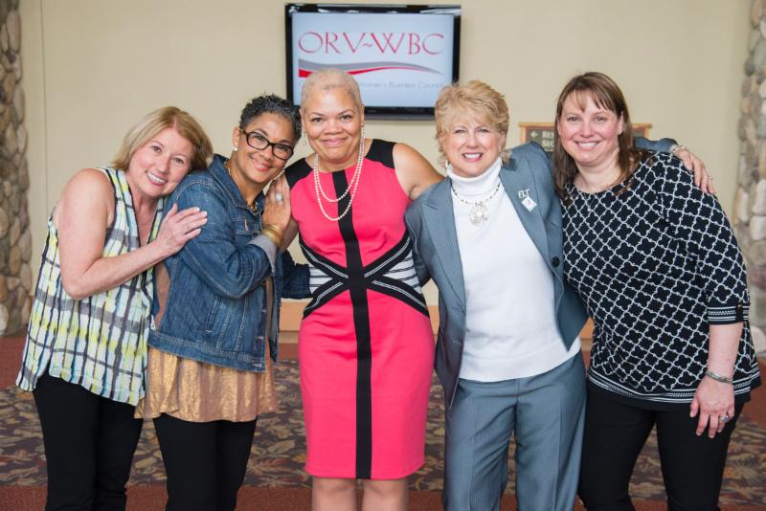
Section 1:
Foundational Knowledge
Notes:
Add ORV LOGO AND CHANGE TEXT

Slide 4
Organizational Background
WBENC was created in 1997 to serve as the leading national third-party certifier for women business enterprises.

Slide 5
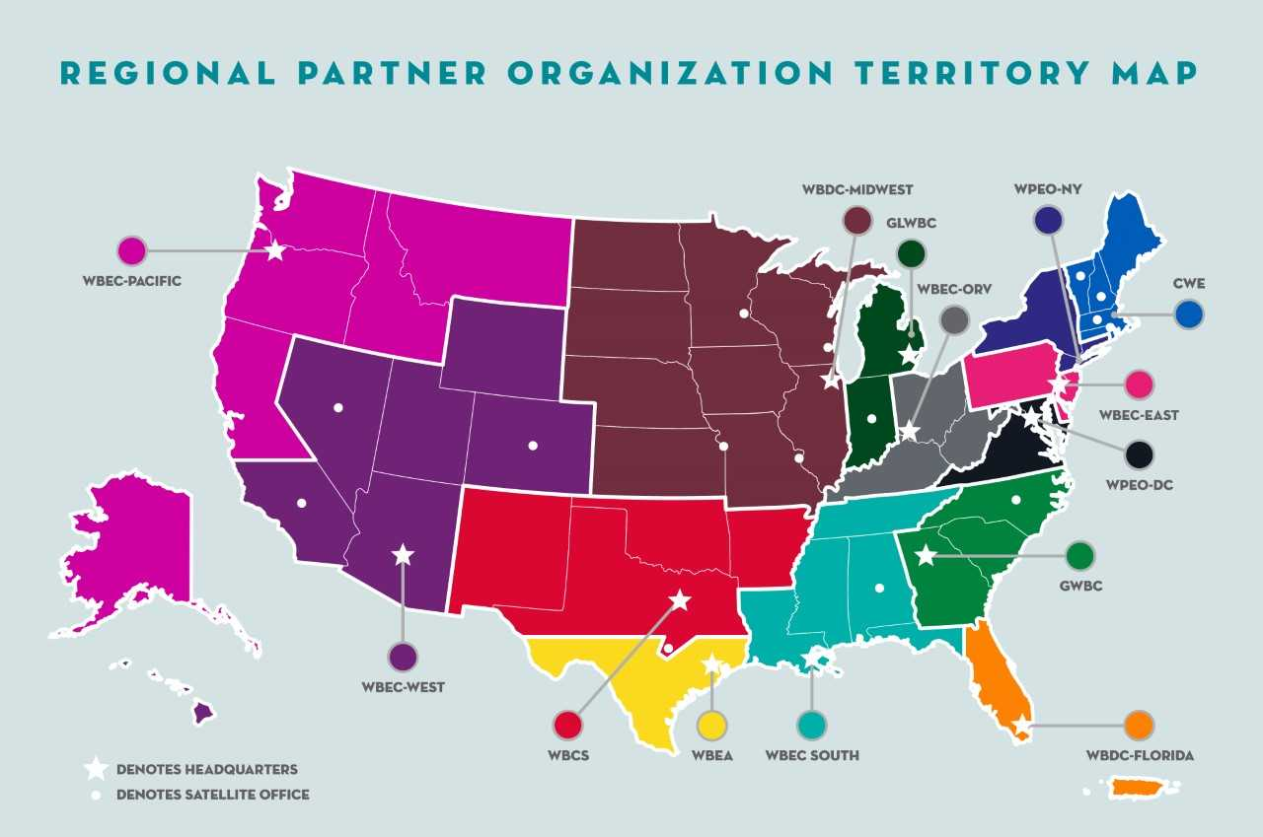
Organizational Background
WBENC’s 14 Regional Partner Organizations

Slide 6
Organizational Background
Services for Ohio, Kentucky, & West Virginia are provided through Women’s Business Enterprise Council Ohio River Valley (one of 14 RPOs). WBEC ORV operates under the Urban League of Greater Cincinnati’s Business Development & Entrepreneurship Department.
Certification
Business training & development
Networking
Matchmaking
WBEC ORV has over 1,000+ certified WBEs and 54 corporate members!

Slide 7
WBE Certification Is Certification Right for You? WBENC places strict requirements on verifying that a business is woman-owned and managed before granting certification. The primary criteria for a business applying for WBENC certification is whether the business has a majority female ownership (at least 51% by one or more women) and is managed by women. Further, women must have unrestricted control of the business, and the highest defined title in the company’s legal documents must be held by a woman.

Slide 8
Self-Assessment Q/A
Is your product/service targeted at corporations, retail and/or government agencies? Typically, only corporations, retail, and government entities request certification, however, some government entities may mandate that you have their "in house" certification.
Does your business have the capacity to deliver quality service/products on large contracts? Corporate and government contracts tend to be larger than contracts many small businesses are accustomed to fulfilling. Your business must be prepared to demonstrate the ability to deliver on these larger contracts. Thousands of WBENC-Certified WBEs compete for business and do business with each other to build their capacity to pursue these opportunities.
Are you willing to share the details of your business including capital investment, tax returns, and compensation records? A key step in the certification process is an analysis of proprietary documents to determine the eligibility of your business. All company proprietary documents and information are treated with the utmost confidentiality.
Are you clear that WBE certification is a marketing tool and DOES NOT guarantee or entitle your company will receive contracts?
If your business is certified, you will need to invest time and energy into developing marketing strategy that targets corporations and government agencies that may need your product or service.
If you answer yes to the questions above, then applying for your WBE certification may be an invaluable strategy to take your business to the next level.

Slide 9
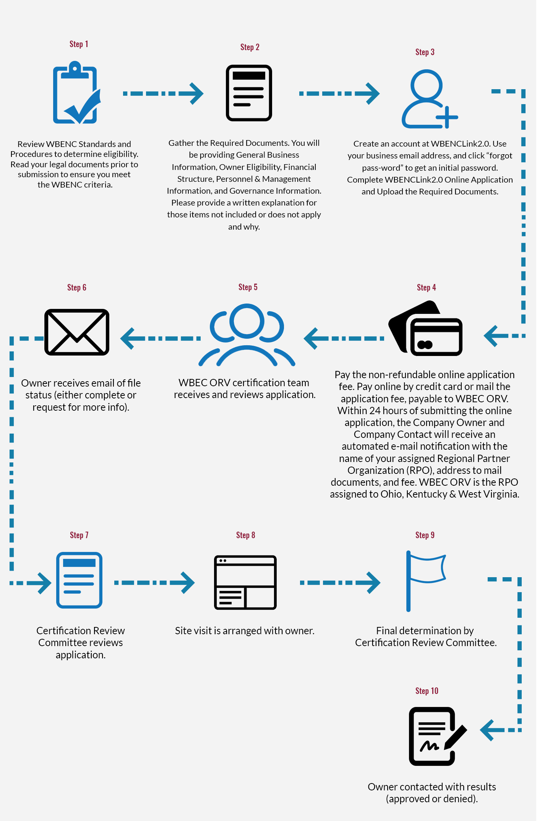

Slide 10
The Value Proposition
Federal Mandate for companies doing business with the federal government - procure 5% of goods and services from women and minorities.
Corporations set up supplier diversity programs in response.
The business model evolved as corporations purchase goods and services from women - women make 80% of the consumer decisions and influence the other 20%.
Many corporations, government entities & non-profit organizations (universities & hospitals) have established inclusion goals.

Slide 11
The Supplier Diversity Advantage
As a WBE, you have an advocate in supplier diversity professionals.
Corporations can make “exceptions” for certified WBEs
Create vendor opportunities in closed community categories
Carve off a piece of a major contracts for a qualified WBEs
Offer mentor/protégé programs
Establish vendor financing mechanisms
As WBENC and the network of certified WBEs grow, the number of corporations with supplier diversity programs that include women will grow.

Slide 12
Catch the Wave Regional Conference
annual event
hosted by WBEC ORV
over 600 attendees
regional networking focus
corporate & WBE workshops
Meet the Buyer event
Business Pitch Breakfast
award recognition
Occurs 3rd week of April
April 21 - 22 in Sandusky, OH
Participate in Your RPO

Slide 13
Quarterly WBE Forum Luncheons (host, present, attend)
Cincinnati
Cleveland
Columbus
Dayton
Louisville
Lexington
Toledo
West Virginia
Participate in Your RPO

Slide 14
Other Regional Events
Women Winning Contracts
Industry-Specific Events
Corporate Member Supplier Diversity events across the region
Participate in Your RPO

Slide 15
ORV BUSINESS DEVELOPMENT PROGRAM (ORVBDP)
Capacity building program for growth-oriented WBEs
In partnership with Procter & Gamble (Cincinnati) and L. Brands (Columbus)
Minimum requirements of 2 years in business and $500,000 annual revenue
Maximum of 10 certified WBE participants each class
Applications accepted each spring (May-June)
Next classes run August 2020 through January 2021
Participate in Your RPO

Slide 16
Webinars
Monthly WBE Onboarding Webinars
Quarterly Maximizing Your Certification Webinars
Annual Catch the Wave Conference Prep Webinar
Monthly WBENCLink 2.0 Webinars
Participate in Your RPO

Slide 17
RPO Engagement (list is not all inclusive):
WBE Forum Luncheon Volunteer Chair or Host
Catch the Wave Sponsor, Presenter, or Volunteer
Submission of company articles, awards, press releases to be featured in the bi-monthly newsletter.
Committee Involvement (certification, programming, marketing & communication, and corporate engagement)
In-Kind Donations of your services or products
Participate in Your RPO

Slide 18
RPO Engagement (list is not all inclusive):
WBENC Star (RPO selection)
Trailblazer Award Recipient (RPO selection)
WBENC Forum Representative (RPO selection)
Tuck WBENC Executive Program (RPO nominee)
Goldman Sachs 10,000 Small Business Program, Babson College (RPO nominee)
Participate in Your RPO

Slide 19
National Conference & Business Fair
annual event
premier WBE exhibitor opportunity
over 350 exhibitors
more than 4,500 WBEs, corporate & gov’t attendees
national networking
Occurs in June Each Year
Summit & Salute
annual event
over 1,600 attendees
national networking
honors WBENC Stars
recognizes top corps
Occurs in March Each Year
Support WBENC National Engagement

Slide 20
WBENC Forum – Expand Your Network!
Forum open to all certified WBEs
Forum leadership opportunities/appointments
WBE to WBE Connections
Learning Opportunities
Collaboration & Partnering
WBENC National Engagement

Slide 21
Thank you for your time & participation!

