Slide 1
WELCOME TO THE
TRISTATE MINORITY SUPPLIER DEVELOPMENT COUNCIL
(TSMSDC)
TUESDAY, SEPTEMBER 22, 2020

Slide 2
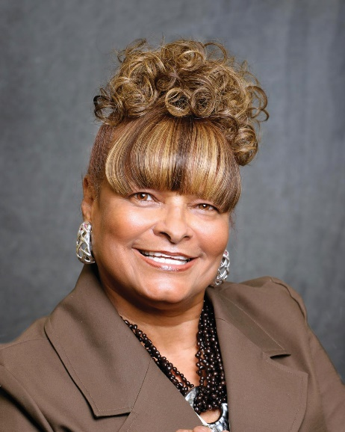
INTRODUCTION
CHERI HENDERSON
President and CEO

Slide 3
WHO WE ARE
TriState MSDC is a 501 (c) (3) non-profit organization chartered to advance business and procurement opportunities for certified minority business, regardless of size, by connecting them to corporate members.
TriState is one of 23 regional affiliate councils of the National Minority Supplier Development Council (NMSDC). It has access to over 1,450 corporate members, including most of America’s largest publicly owned, privately owned, and foreign owned companies, as well as universities, hospitals and other buying institutions. Collectively, over 12,000-plus minority-owned businesses are matched with member corporations that seek to purchase goods and services.

Slide 4
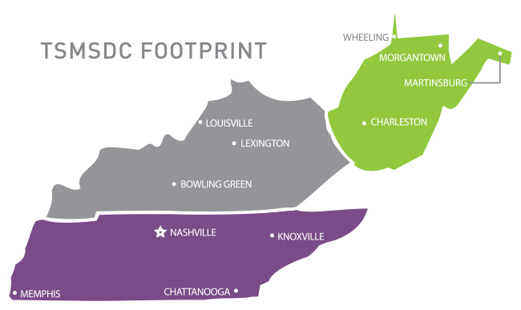
TENNESSEE | KENTUCKY | WEST VIRGINIA

Slide 5
WHO WE ARE
MISSION: TSMSDC ensures the development of mutually beneficial relationships between ethnic minority businesses (suppliers) and major corporations (purchasers), by promoting and expanding business and procurement opportunities as they strive to be the product and service providers of choice.
VALUE PROPOSITION: TSMSDC is committed to being the leading supplier diversity advocate, to facilitate relationships between corporations and MBEs, resulting in improved sales, profits, business performance, consumer image and stakeholder value.

Slide 6
WHAT WE DO
TSMSDC’s commitment is to bring the highest level of service to all its stakeholders.
Four (4) fundamental pillars represent our overall mission: CERTIFY | DEVELOP | CONNECT | ADVOCATE
CERTIFY: Minority-owned businesses and promote the value of certification
DEVELOP: Stakeholders and building capacity and capabilities
CONNECT: Connect certified MBEs with local and national corporate members
ADVOCATE: MBEs and major purchasers promote the Value Proposition of Supplier Diversity

Slide 7
SERVICES
Identify, certify, assist and refer in the scalability of MBEs in a wide range of products and services
Access the needs of corporate members regarding their supply chain requirements and match appropriate MBE suppliers
Develop and offer supplier diversity program support
Measure and track business and networking opportunities
Assist in RFP/bid opportunities
Source MBE referrals and introductions
Deliver education and training opportunities
Facilitate business relationships
Promote equity, diversity and inclusion

Slide 8
TSMSDC BOARD OF DIRECTORS
Dr. Herman Williams, Chairman – Nashville BDO Healthcare Advisory Practice
Jackie LaJoie, Vice Chair - Trane Technologies Stanford Williams, Treasurer – Messer Construction Co.
Attorney Richard Manson, Legal Counsel – SourceMark USA Maria Teresa ‘Tera’ Vazquez, MBEIC Chair – Guy Brown Cheri K. Henderson, President and CEO – TriState MSDC
Keith Hamilton - LB Manufacturing, LLC (MBEIC – KY)
Anthony Mathis - Norton Healthcare
Warren Sawyers – Atlas Management Corporation
Attorney Kim Stagg – Dickinson Wright, PLLC

Slide 9
WHAT WE DO
FOR MINORITY OWNED BUSINESSES
Certify ethnic minority-owned businesses
Provide access to working capital
Create networking opportunities
Provide business-building educational seminars
Recommend Executive Management Educational Programs
FOR CORPORATIONS
Provide referrals and access to certified minority suppliers
Provide assistance in supplier diversity programs
Enhance corporate presence to assist with procurement goals
Information clearinghouse on minority businesses development
Recommend Advanced Programs Managers Seminars

Slide 10
BENEFITS OF AFFILIATION
Creating partnerships, strategic alliances, and contractual relationships
Executive business management scholarships for continuing education
National certification accepted by over 1,450 major corporations
Greater access to the marketplace for business opportunities
Forums for information exchange, dialogue, and networking
Cultivate economic opportunities with major corporations
Inclusion in NMSDC’s national database of more than 12,000 MBEs
Direct contact with corporate decision-makers
Publicity through on-line and printed materials
Support Tier 1 and 2 business relationships
Contacts… Contracts

Slide 11
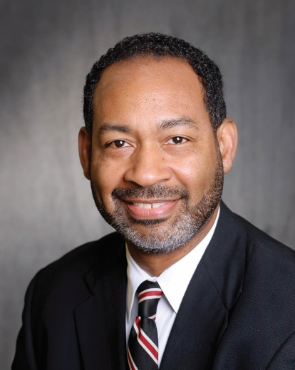
MBE CERTIFICATION/
EDUCATION FOUNDATION
DERRICK DOWELL
Vice President

Slide 12
WHAT IS MBE CERTIFICATION?
Certification is a validation process that validates:
The company is a for profit enterprise
At least 51% owned, managed and controlled by minority group member(s)
Physically located in the United States or its trust territories

Slide 13
HOW DO I GET CERTIFIED?
Step 1: Review the certification criteria and checklist to ensure that your business qualifies. This can be found on www.tsmsdc.net – MBE Certification webpage.
Step 2: Collect the required documentation.
Step 3: Complete the application online. Notarize the Declaration of Minority Status page, submit the payment, the application and documentation online. The payment information is listed
Step 4: The applicant will go through a desk audit. The desk audit is a review of the entire application and all supporting documentation. It is also during this stage where we contact your business references.
Step 5: Once the desk audit is complete, the files goes into the site visit stage. The site visit is a personal visit to the applicant’s business to meet with principals and review certain documents to verify ownership, management and control functions. A report of the site visit is prepared and added to the file.
Step 6: Your completed packet will be forwarded to the Certification Committee for a review and make a recommendation to the Board of Directors for final action.
Step 7: The Board of Directors review and vote on the committee’s recommendations. All letters are prepared for signature after the vote.
Step 8: All applicants receive a written notification of their status within one week. Firms that are approved are granted certification that is good for one (1) year and requires an annual renewal.
Note: The above process can take anywhere from 30 to 90 days depending on when the application arrives in relationship to the certification meetings.

Slide 14
YOUR CHECKLIST TO GET STARTED
Create and update your company profile in NMSDC Central
Be part of the news and share your success stories and get visibility
Participate in webinars and workshops hosted by TSMSDC
Monitor TSMSDC’s News and Education section on the website
Keep an eye on TSMSDC events posted in Events section on the website
Attend events presented by TSMSDC and NMSDC

Slide 15
READY TO DO BUSINESS?
BE PREPARED:
Action Plan :
Who am I targeting?
What are my strengths?
Why me?
How can I deliver?
Know your audience – Research the companies you are targeting (MBEs and Corporations)
Register in your target companies’ Supplier/Supplier Diversity Registration Portals - found on their websites
Update your Capability Statement and business collateral to suit the targeted client
Perfect your Elevator Pitch

Slide 16
PUT THINGS IN MOTION
EXECUTE YOUR PLAN:
Attend TSMSDC and NMSDC events
Look for MBE sponsorship opportunities
Get Involved with TSMSDC as a volunteer at events
Find Corporate and MBE Mentors
Ask for introductions to key individuals and targeted corporations
Give back- participate in supporting diverse businesses
NETWORK, NETWORK, NETWORK! ! !

Slide 17
MEASURE YOUR SUCCESS
EVALUATE YOUR PLAN:
Have you met the right people?
Which events; seminars; workshops were useful?
Any new business prospects to follow up on?
How can you improve?
Have you developed a short and long-term strategy?
Ask for help
EEeEvads

Slide 18
BENEFITS AND ADVANTAGES OF BEING MBE CERTIFIED
Access to purchasing opportunities
Validation of MBE status
MBE Development
Networking Events
Access to educational programs and training
Access to capital
Our Certification is accepted by other certifying agencies
Greater opportunity to provide products and services to Corporate America
Direct access and exposure to corporate decision makers
Bid notification
Inclusion in national database
Trade Fair and Matchmaker events
Access to NMSDC Network
Referrals
MBE Orientation

Slide 19
ANNUAL RE-CERTIFICATION
Certified MBEs will receive 30, 60, and 90 day e-mail notices of their pending expiration
Re-certification application is completed online at www.tsmsdc.net
Any changes of ownership must be documented and submitted on the re-certification application
Allow 30 days to process the re-certification application
It is the MBE’s responsibility to re-certify prior to certificate expiration

Slide 20
SUBSCRIPTION SERVICES
This service is available to NMSDC Certified MBEs that are doing business in other regions, in addition to their Home Councils
A subscription entitles a certified MBE to access additional services at your Home Council and from any of the 23 regional councils within the NMSDC network
Contact the Regional Council of choice for details about Subscription Services. Go to http://www.nmsdc.org/nmsdc-regional-affiliates-list/

Slide 21
TSMSDC SUBSCRIPTION SERVICES
SERVICES INCLUDE:
RFP Business Leads
Alerts from Corporate Members
TriState Executive to Corporate Meetings
Industry Groups/Committees
Listing in National Database
Calendar of Events
Letters of Introduction
One-on-One Corporate Meetings
Community Business News Bulletin
Access to Educational Workshops
inBusiness Magazine Ad
Access to Executive Management Programs
Webinar
SUBSCRIPTION SERVICES FEES:
CLASS 1: $300 | CLASS 2: $400 | CLASS 3: $500 | CLASS 4: $600

Slide 22
MINORITY BUSINESS ENTERPRISE INPUT COMMITTEE (MBEIC)
The MBEIC is the liaison between TSMSDC’s corporate members, and is the voice of MBE affiliates
MBEIC is a standing committee of the TSMSDC Board of Directors
MBEIC members are elected into membership by TSMSDC certified MBEs
The MBEIC role is to provide board members and the council staff with constructive and solution-orientated input on issues affecting MBEs, promote council activities and execute initiatives to strengthen and support the certified MBE community as a whole
TSMSDC works collaboratively with MBIEC to promote council programs to enhance the development and growth of our regions
TSMSDC MBEIC Chair: Maria Teresa ‘Tera’ Vazquez, President and CEO – Guy Brown
TSMSDC MBEIC Vice Chair: Attorney Richard Manson, President and CEO – SourceMark USA

Slide 23
EDUCATION FOUNDATION
Inaugurated in 1994 in Nashville, Tennessee
Mission: To provide support to at-risk graduating seniors to continue their education beyond high school
Success: $2 million in scholarships to 362 high school graduates. Scholarships are made possible by generous donations from corporations, minority businesses, community partners, and individuals

Slide 24
ACTIVE PARTICIPATION
SUSAN A. L. MARSTON, MBA
Regional Vice President
Kentucky and West Virginia

Slide 25
HOW TO GET THE MOST OUT OF TSMSDC…
PARTICIPATE …
PARTICIPATE …
PARTICIPATE!!

Slide 26
2020 UPCOMING EVENTS
October 7: 'Raising the Bar' Mini-Series – Trane Technologies and TSMSDC - Featuring… The Hatchett Group Seizing the Opportunity for Supplier Diversity: Is Your Supplier Diversity Program Ready for Greater Expectations and Visibility? 11:00 am - 12:00 pm EST/10:00 am - 11:00 am CST
October 14: 'Raising the Bar' Mini-Series with Trane Technologies and TSMSDC…
Workshop II - Risk Management: 11:00 am - 12:00 pm EST/10:00 am - 11:00 am CST
November 18: Part 3 Series of Messer Construction/City of Knoxville/Knox County/TSMSDC
‘Get It Done’… Building for Tomorrow Construction Seminar - Diversity/Inclusion in Construction:
8:30 am - 9:30 am EST/7:30 am - 8:30 am CST
December 2: 'Raising the Bar' Mini-Series with Trane Technologies and TSMSDC…
Workshop III - Quality: 11:00 am - 12:00 pm EST/10:00 am - 11:00 am CST

Slide 27
OPPORTUNITIES
NMSDC National Conference and Business Opportunity Exchange
Matchmaking Sessions
Meet the Buyer Events
Marketing and Leadership Training
Webinars
Workshops
Newsletters
Website Success Stories
Supplier of the Year Awards!
Referrals

Slide 28
THANK YOU!
For additional information, contact:
Tennessee Headquarter Office T: (615) 259-4699
Kentucky Regional Office T: (502) 365-9762
E: info@tsmsdc.net
W: tsmsdc.net (Regional)
W: nmsdc.org (National)

